Slide 1



PHISHNG ATTACKS
BY :
FATIMA ZAHRAE LAAROUSSI

Slide 2


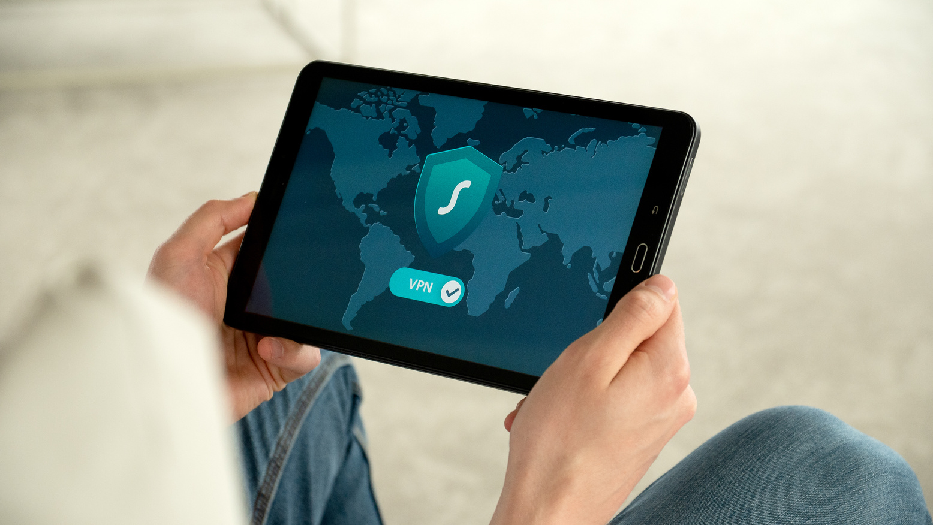

INTRODUCTION
In today’s digital world, cyber threats are evolving rapidly and phishing remains one of the most persistent and dangerous tactics used by attackers. This training was created as part of my cybersecurity internship to raise awareness about phishing techniques and help others recognize and avoid common traps. Whether you're a student, employee, or everyday internet user, understanding how phishing works is essential to staying secure online.

Slide 3
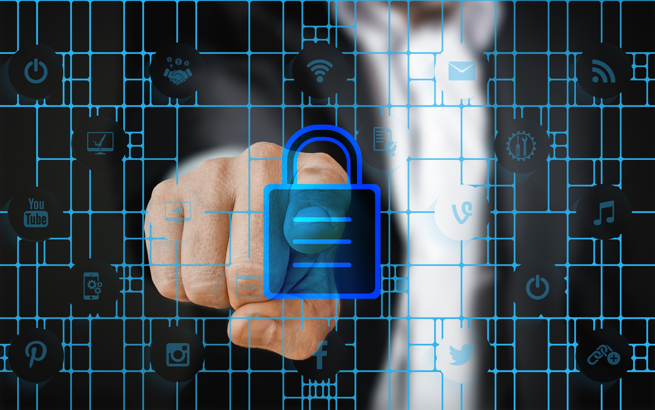
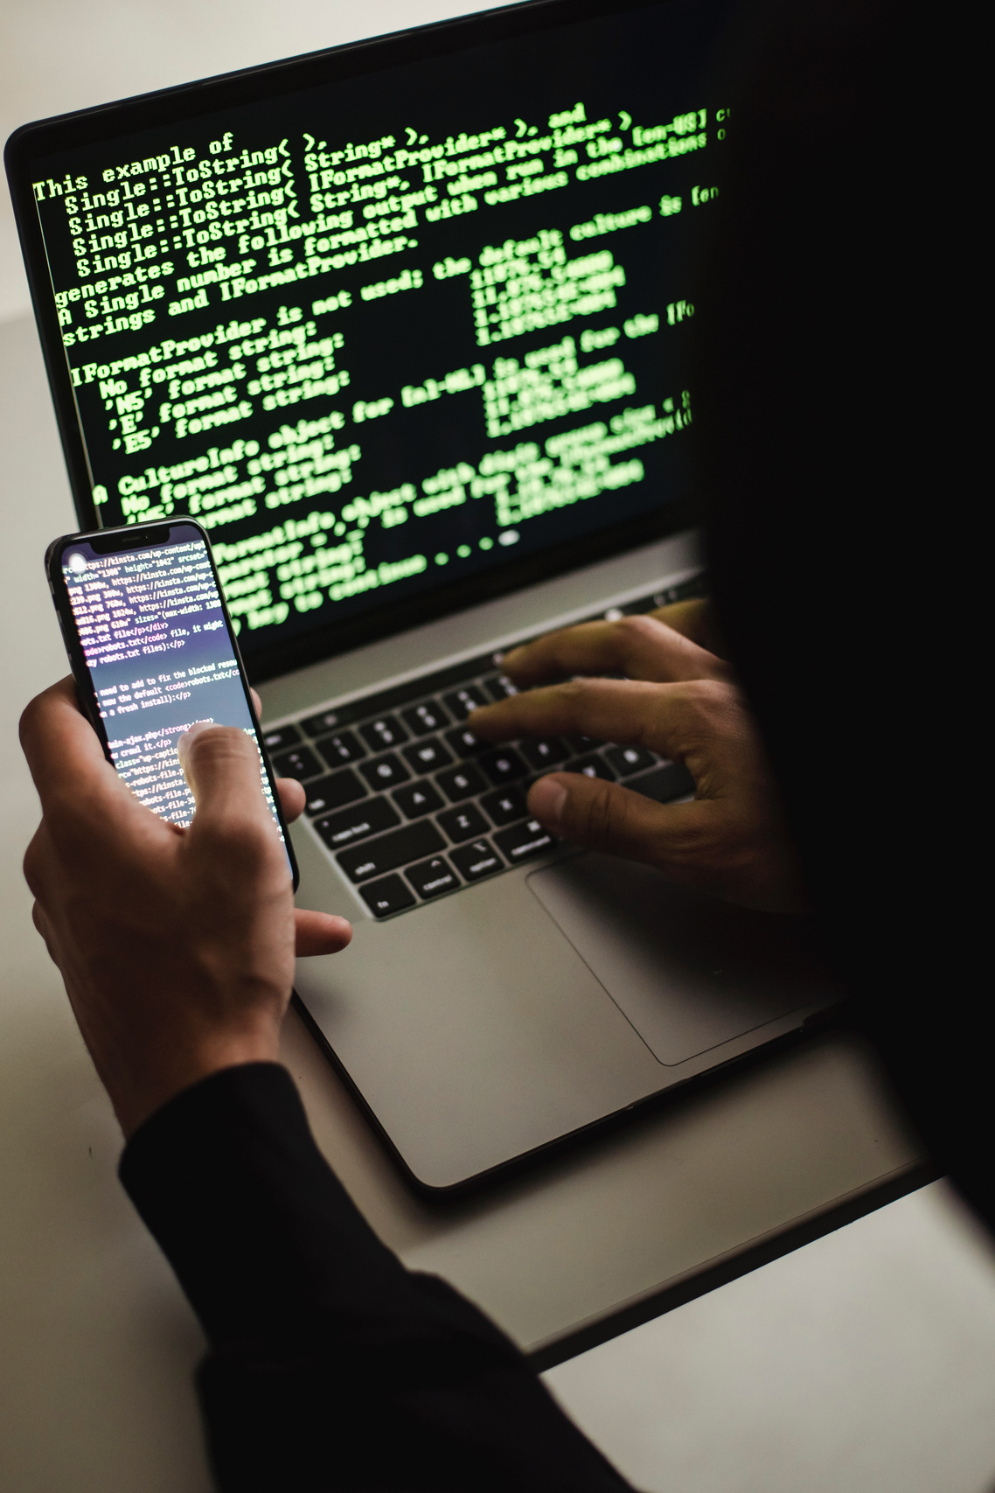
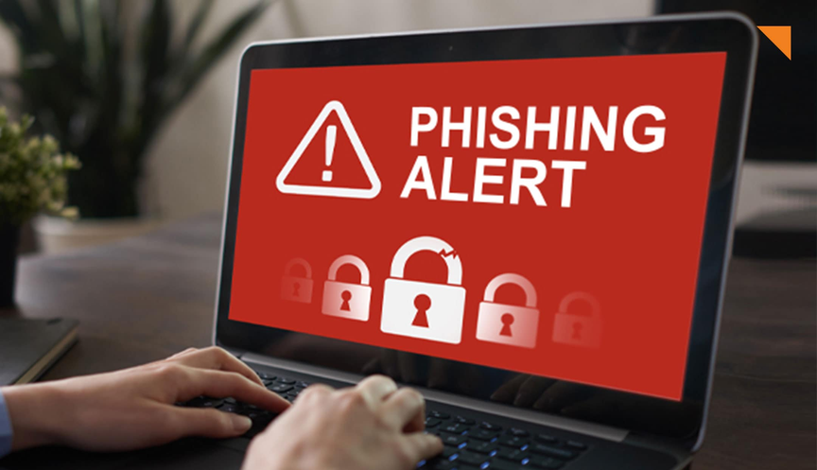
WHAT IS PHISHING?
Phishing is a type of cyberattack where attackers pretend to be trusted entities (such as a bank, company, or colleague) to trick people into revealing sensitive information like passwords, credit card numbers, or login credentials.
REAL-WORLD EXAMPLES:
✉️ Email Phishing
You receive an email that looks like it’s from your bank asking you to "verify your account" through a fake link.
📱 SMS Phishing (Smishing)
A message says:
"Your package couldn’t be delivered. Please click here to reschedule."
But the link leads to a fake website that collects your data.
🌐 Social Media Phishing
A message from a hacked friend’s account says:
"Check this video of you! 😂 [link]"
When clicked, it asks for your login details.

Slide 4
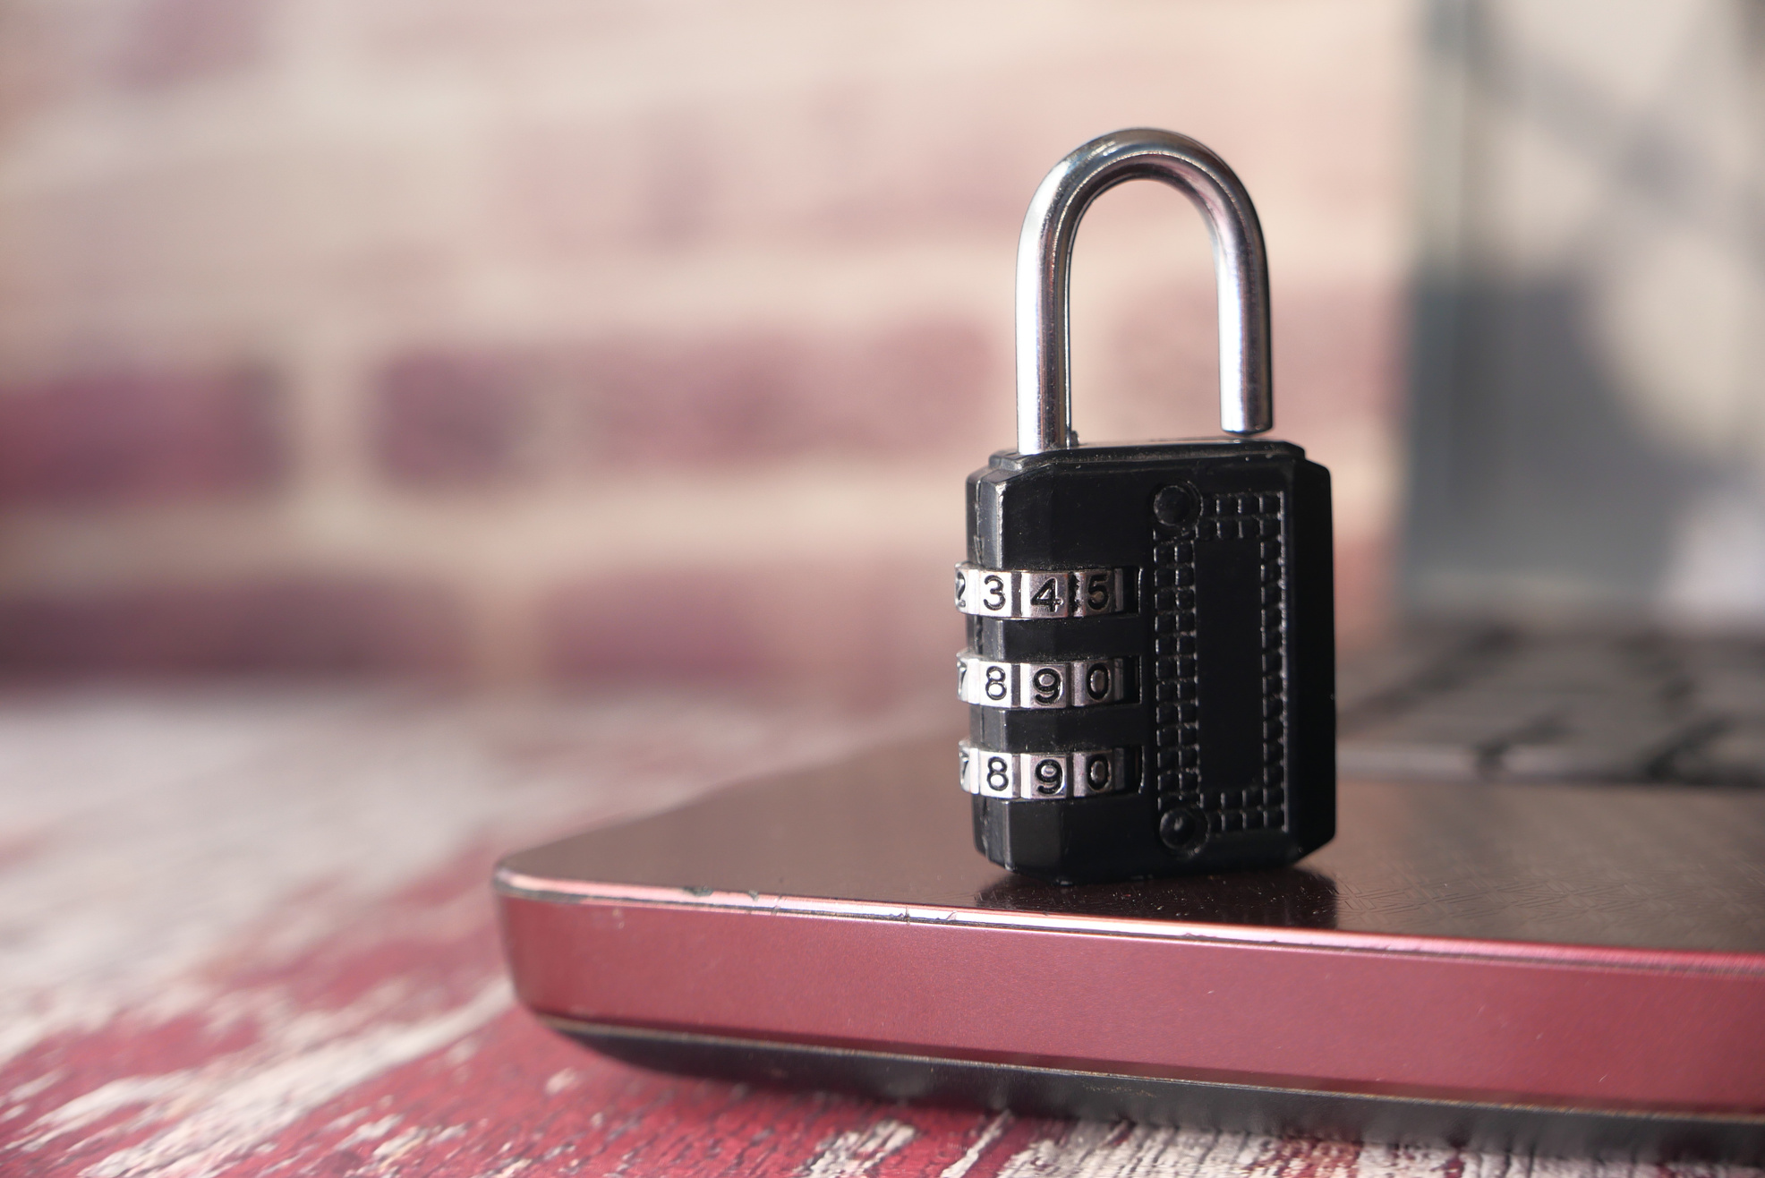
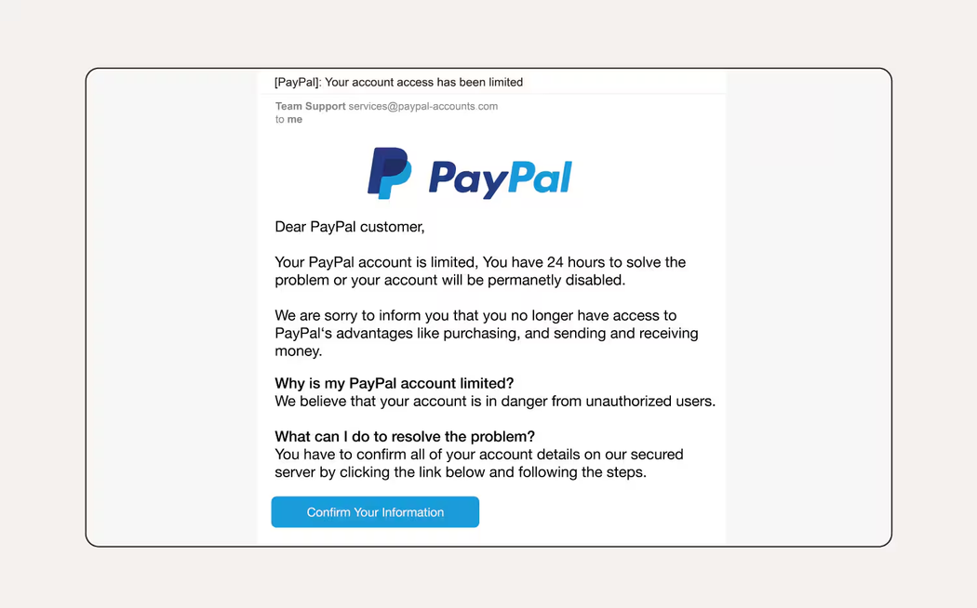
1. Urgent or Threatening Language
“Your account will be suspended in 24 hours”
“URGENT: Confirm your login immediately”
Attackers create panic to make you act without thinking.
2. Fake or Mismatched Links
Hover over links before clicking they often look legitimate, but redirect to malicious sites.
Example:
Displayed: www.paypal.com
Actual: www.paypa1.com/login
3. Suspicious or Misspelled Sender
Real: support@apple.com
Fake: support@appl3-security.com
4. Unexpected Attachments (.exe, .zip, .html)
Never open unknown or unexpected attachments — they may contain malware or ransomware.
RED FLAGS IN PHISHING EMAILS

Slide 5
SOCIAL ENGINEERING TECHNIQUES
🧠 Technique | 💬 Description | 📌 Example
Pretexting | The attacker creates a false scenario to trick the victim into revealing info. | “I’m from IT support. I need your login to fix an issue.”
Impersonation | Pretending to be a trusted person (boss, colleague, technician). | Email from “HR” asking for tax details or a call from “the bank.”
Urgency Traps | Creating panic or pressure to push the victim to act without thinking. | “Your account is locked! Click here in the next 10 minutes to restore access.”

Slide 6
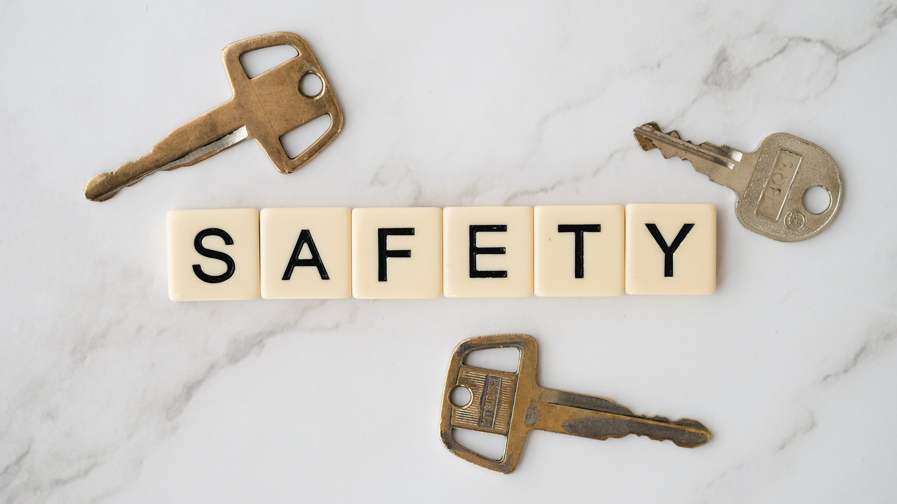
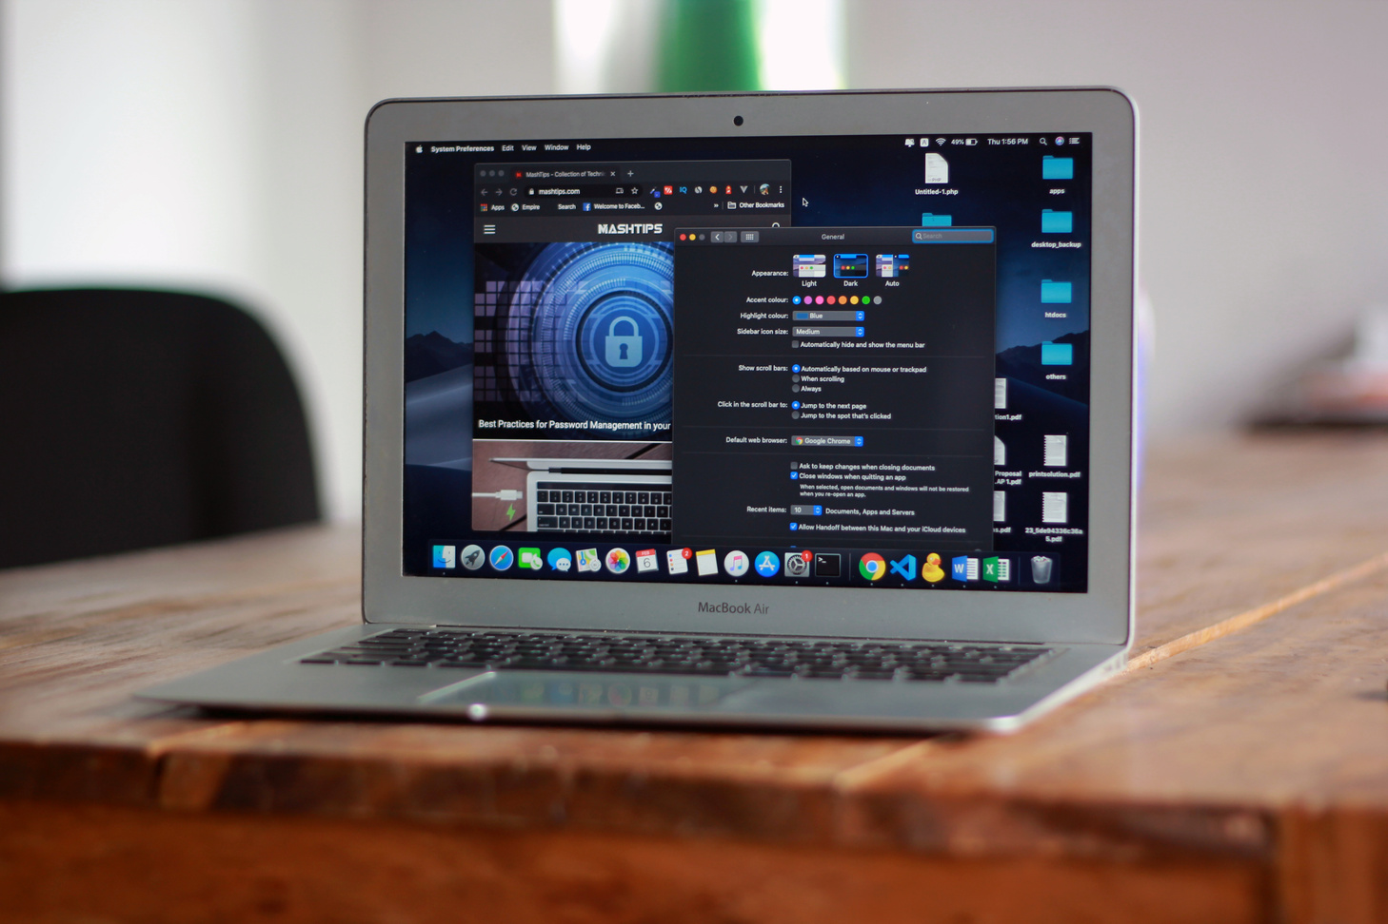
🔗1. Never Click Unknown Links
Don’t trust links in emails or messages from unknown or unverified sources.
Hover over the link to preview the destination before clicking.
🔍 2. Always Verify URLs
Make sure the website URL is correct and secure (starts with https://).
Watch for slight changes in the domain (e.g. g00gle.com instead of google.com).
🔒 3. Never Share Your Credentials
No legitimate company will ask you for your password, PIN, or security code via email or message.
🔐 4. Use Two-Factor or Multi-Factor Authentication
Add an extra layer of protection even if your password is stolen.
Use authentication apps (like Google Authenticator or Authy) rather than SMS if possible.
HOW TO PROTECT YOURSELFS

Slide 7
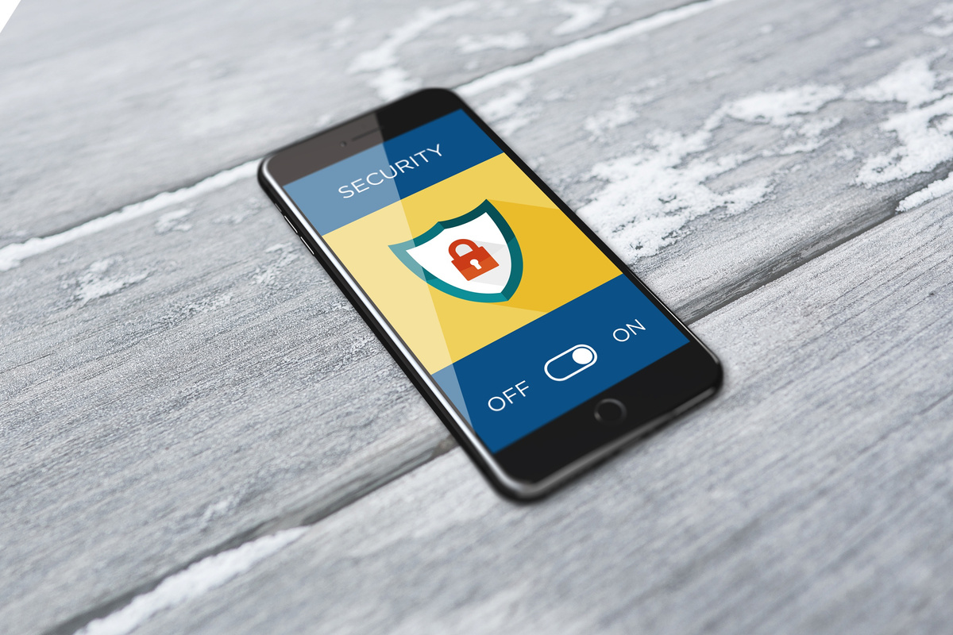
WHAT TO DO IF YOU SUSPECT A PHISHING ATTACK
🛑 1. Do Not Click or Respond
Avoid clicking on any links or replying to the message.
Don’t download attachments.
📣 2. Report It Immediately
Forward the email to your IT department or security team.
Mark the message as spam or phishing in your email client.
🧠 Example: In Gmail, click the three dots → "Report phishing"
📤 3. Don’t Forward It to Others
Even if you’re trying to warn someone, forwarding a phishing message increases the risk of spreading it.
💻 4. If You Already Clicked the Link:
🔌 Disconnect from the internet (especially if it downloaded a file)
🔐 Change your passwords immediately
🦠 Run a malware/antivirus scan

Slide 8

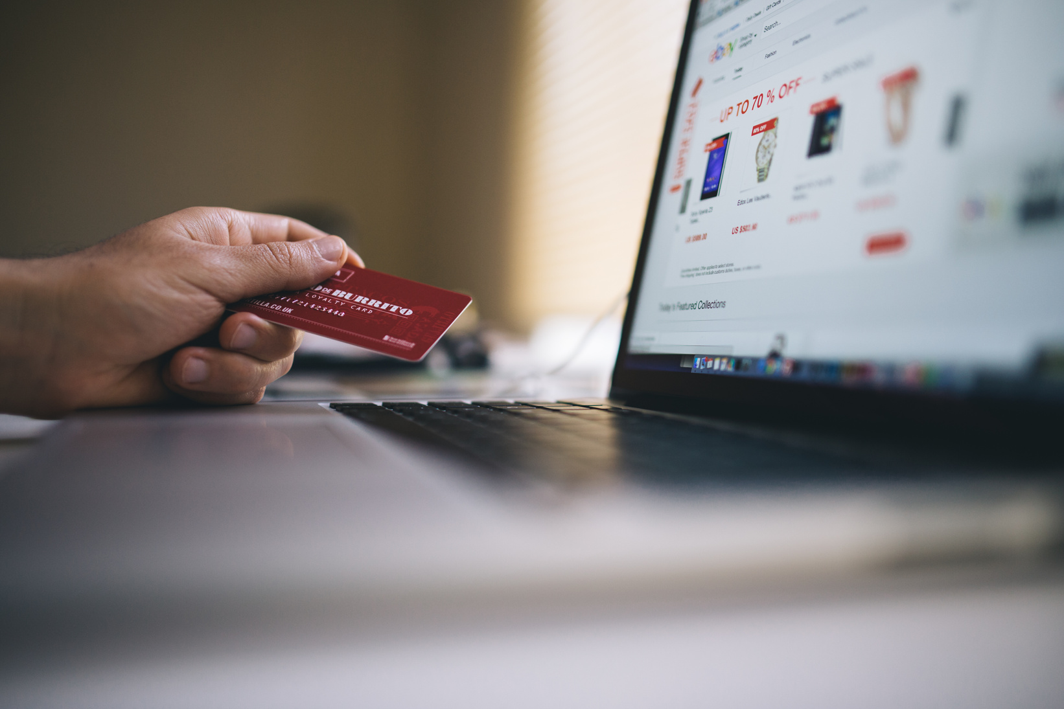
CONCLUSION
Phishing attacks are becoming more sophisticated every day but with the right knowledge and awareness, they are also highly preventable.
Through this training, you've learned how to identify red flags, understand attacker tactics, and most importantly, how to protect yourself and others.
💡 Cybersecurity is everyone’s responsibility staying alert and cautious can make a real difference.
Stay safe, stay secure.

Slide 9
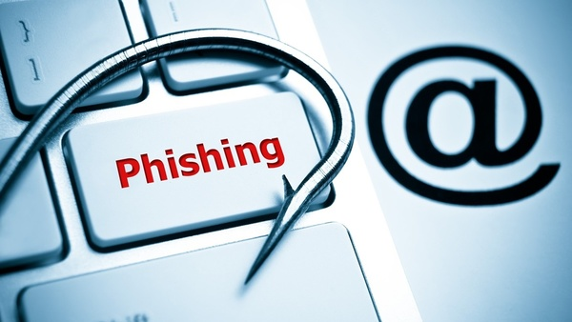
THANK YOU

